Slide 1


Python for DevOps: Object-Oriented Programming and Libraries
| DevOps and Cloud Computing

Slide 2

Objective
Understand the principles of object-oriented programming (OOP) in Python.
Learn how to use classes, objects, and inheritance in Python programs.
Explore Python libraries that simplify DevOps tasks.
Use regular expressions to perform pattern matching and text processing.

Slide 3
Introducing OOP concepts
| DevOps and Cloud Computing

Slide 4
Object-Oriented Programming (OOP)
Object-oriented programming (OOP) is a programming paradigm based on "objects" that contain data in the form of fields (attributes) and code in the form of procedures (methods).
OOP focuses on creating reusable code by grouping data and methods that operate on that data into objects.
The four main principles of OOP are encapsulation, abstraction, inheritance, and polymorphism.

Slide 5
Object-Oriented Programming (OOP)
Classes and Objects
Class A class is a blueprint or a template for creating objects. It defines the attributes (data) and methods (behavior) that the objects of that class will have.
Object An object is an instance of a class. It is a concrete entity that exists in memory and has its own unique state (values of attributes).
For example, consider a class called "Server". It might have attributes like ‘server ID’, ‘Ip address', ‘status’, and ‘memory usage’ and methods like ‘start()’, ‘stop()’, ‘restart()’, and ‘update status()’.

Slide 6
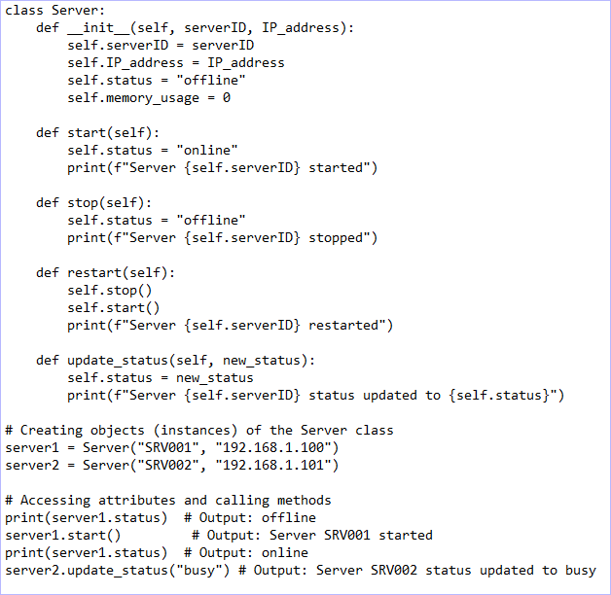
Object-Oriented Programming (OOP)

Slide 7
Object-Oriented Programming (OOP)
In the above example, ‘Server’ is a class, while ‘server1’ and ‘server2’ are objects (instances) of the ‘Server’ class. Each server object has its own ‘server ID’, ‘IP address’, ‘status’, and ‘memory usage’.
OOP Principles:
Encapsulation
Abstraction
Inheritance
Polymorphism

Slide 8
Demonstrating creating a class, defining attributes and methods, and creating objects
| DevOps and Cloud Computing

Slide 9
Let’s do it
Okay, here's a short demonstration of creating a class, defining attributes and methods, and creating objects using a simplified ‘Dog’ example:

Slide 10
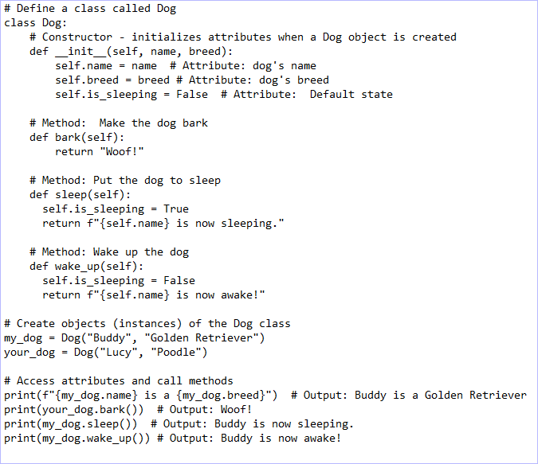
Let’s do it

Slide 11
Explaining Inheritance
| DevOps and Cloud Computing

Slide 12
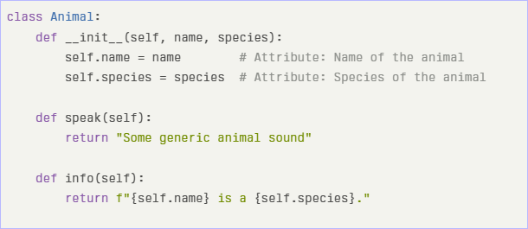
Inheritance
Inheritance is a fundamental concept in object-oriented programming that allows a class (known as the child or subclass) to inherit properties and methods from another class (known as the parent or superclass).
Example of Inheritance
Parent Class: Animal
The ‘Animal’ class serves as the base class, defining common attributes and methods for all animals.

Slide 13
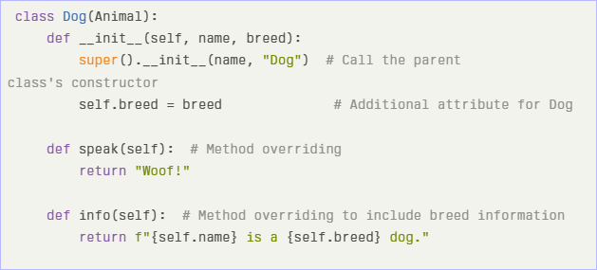
Inheritance
Child Class: Dog
The ‘Dog’ class inherits from the ‘Animal’ class and provides specific implementations.

Slide 14
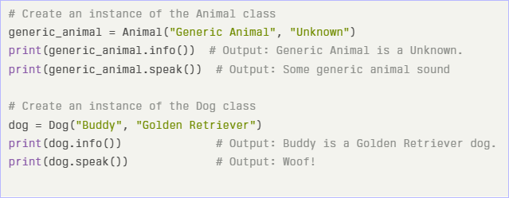
Inheritance
Creating Instances and Demonstrating Inheritance
Now, let’s create instances of both classes and demonstrate how inheritance works.

Slide 15
Inheritance
Method Overriding:
When calling ‘speak()’ on an instance of ‘Dog’, it executes the overridden method in the ‘Dog’ class instead of the one in the ‘Animal’ class.
Similarly, calling ‘info()’ on a ‘Dog’ instance provides more specific information than calling it on a generic animal.

Slide 16
Providing an overview of popular DevOps-related Python libraries

Slide 17
Overview
Here's an overview of popular Python libraries used in DevOps:
OS module: This module allows interaction with the operating system, enabling tasks such as file and directory manipulation.
subprocess: Along with the os module, subprocess is used for executing shell commands and scripts.
boto3: This is the AWS SDK for Python, which allows you to manage AWS resources. It enables DevOps engineers to automate the management of AWS services, such as EC2, S3, and Lambda, directly from Python scripts.
Paramiko: Paramiko is an SSH library that facilitates secure communication with remote servers. It enables you to execute commands, transfer files, and manage remote servers securely via SSH, making it crucial for automating tasks across a network of machines.

Slide 18
Overview
Paramiko: Paramiko is an SSH library that facilitates secure communication with remote servers. It enables you to execute commands, transfer files, and manage remote servers securely via SSH, making it crucial for automating tasks across a network of machines.
Ansible: Ansible is a powerful automation tool that is particularly useful for system management duties. It is coded purely in Python.

Slide 19
Demonstrating a simple use case for one of these libraries
| DevOps and Cloud Computing

Slide 20
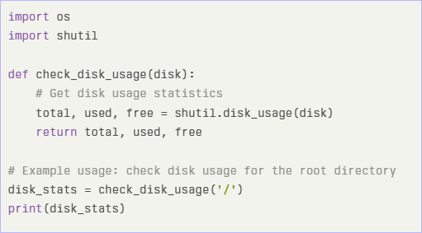
Let’s do it
Checking Disk Usage with Python
You can utilize the ‘shutil.disk usage()’ function to retrieve information about the total, used, and free disk space for a specified path. Here’s a brief example:

Slide 21

Let’s do it
Execution Results:
When you run this code, it will provide output similar to:
This output represents:
Total disk space: approximately 9.09 GB
Used disk space: approximately 3.78 GB
Free disk space: approximately 5.29 GB

Slide 22


Take A 5-Minute Break!
Stretch and relax
Hydrate
Clear your mind
Be back in 5 minutes

Slide 23
Introducing regular expressions and their role
| DevOps and Cloud Computing

Slide 24
Regular expressions
Regular expressions (regex) are special text strings that serve as patterns for describing and matching specific amounts of text.
They provide a concise and flexible means to manipulate text data.
Regular expressions are a powerful tool that can save time and effort when extracting information, validating user input, or parsing text files.

Slide 25
Regular expressions
Key aspects of regular expressions:
Pattern Matching: Regexes are used to find or match patterns present in text. They define a search pattern, allowing you to easily match and extract specific substrings from text data.
Text Processing: They are used in text processing for defining patterns that can match specific sequences of characters within a target string.
Flexibility: Regular expressions allow expressing complex patterns in a compact and readable form.
Versatility: They can be used for find-and-replace operations, data transformation tasks, and validating input data like emails and phone numbers.
Efficiency: When used correctly, regexes can significantly speed up text processing tasks

Slide 26
Explaining basic components of regex
| DevOps and Cloud Computing

Slide 27
Basic components of regex
Regular expressions consist of several basic components:
Patterns:
Literals: Ordinary characters that match themselves (e.g., 'a' matches 'a').
Metacharacters: Special characters with specific meanings (e.g., ‘.’ matches any character, ‘(backslash)d’ matches any digit).
Quantifiers: Specify the number of occurrences (e.g., ‘*’ for zero or more, ‘+’ for one or more, ‘{n}’ for exactly n occurrences).

Slide 28
Basic components of regex
Anchors:
‘^’: Matches the start of a string.
‘$’: Matches the end of a string.
Groups and Character Classes:
Groups: Enclosed in parentheses ‘()’, they capture parts of the match (e.g., ‘(abc)’ captures 'abc').
Character Classes: Defined by square brackets ‘[ ]’, they match any one of the enclosed characters (e.g., ‘[a-zA-Z]’ matches any letter).

Slide 29
Demonstrating using Python’s re module for common tasks
| DevOps and Cloud Computing

Slide 30
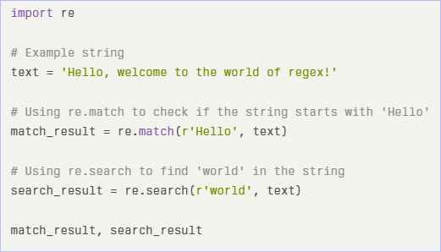
Let’s do it
Here's a demonstration of common tasks using Python's ‘re’ module for regular expressions:
1. Matching Strings
Using ‘re.match’ and ‘re.search’:

Slide 31
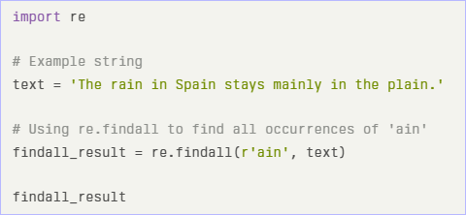
Let’s do it
Execution Results:
match result: A match object indicating that the string starts with 'Hello'.
search result: A match object indicating that 'world' is found at position 22.
2. Finding Patterns
Using ‘re.findall’:

Slide 32
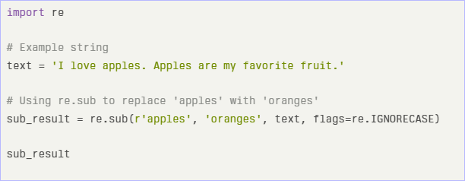
Let’s do it
Execution Results:
‘findall result’: A list containing all occurrences of 'ain': ['ain', 'ain', 'ain', 'ain'].
3. Replacing Text
Using ‘re.sub’:
Execution Results:
sub result: The modified string: "I love oranges. oranges are my favorite fruit."

Slide 33
Time for case study!

Slide 34
Important
Complete the post-class assessment
Complete assignments (if any)
Practice the concepts and techniques taught in this session
Review your lecture notes
Note down questions and queries regarding this session and consult the teaching assistants

Slide 35
Thanks!

